Slide 1


Your Emirati
Partner in Luxury
Elevator & Vertical Mobility Solutions

Slide 2

ABOUT MASSAED
Why MASSAED?
MASSAED is a UAE-based solution provider specialising in the design, supply, installation, maintenance, repair, and modernisation of elevators and escalators.
Emirati Origin
Global Standards
Tailored Solutions
Curated Technology
Precision Execution
Reliability by Design
Long-Term Partnership
Lifecycle Performance
Established in 2008
UAE-based vertical mobility solutions provider
Design, Supply, Installation, Maintenance & Modernization
Serving the UAE and international markets

Slide 3















Core Values:
VISION
Excellence in Every Detail
To be a leading force in shaping the future of urban mobility across the region and beyond.
Safety Without Compromise
Reliability You Can Trust
MISIION
Innovation with Purpose
To deliver intelligent vertical mobility solutions that redefine safety, efficiency, and comfort across modern developments.
Partnership-Driven Approach
Integrity & Accountability

Slide 4


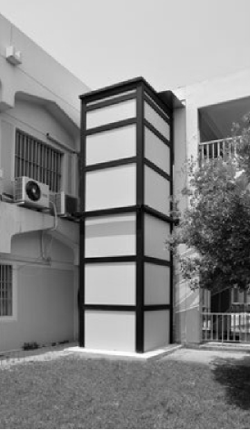
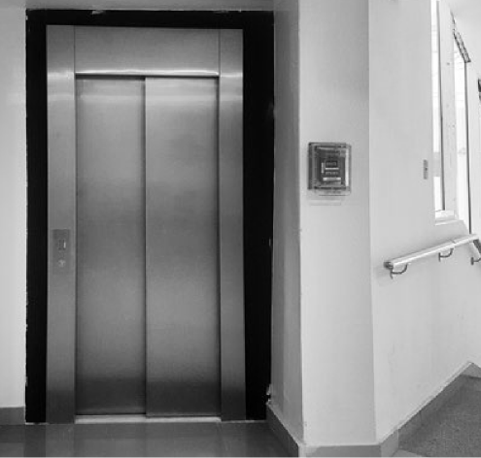


EMIRATI FOUNDATION
Reframing the installation as brand representation:
Proudly established in the UAE
Built on clarity of vision and speed of execution
Committed to uncompromising quality
Supporting modern infrastructure across the region

Slide 5
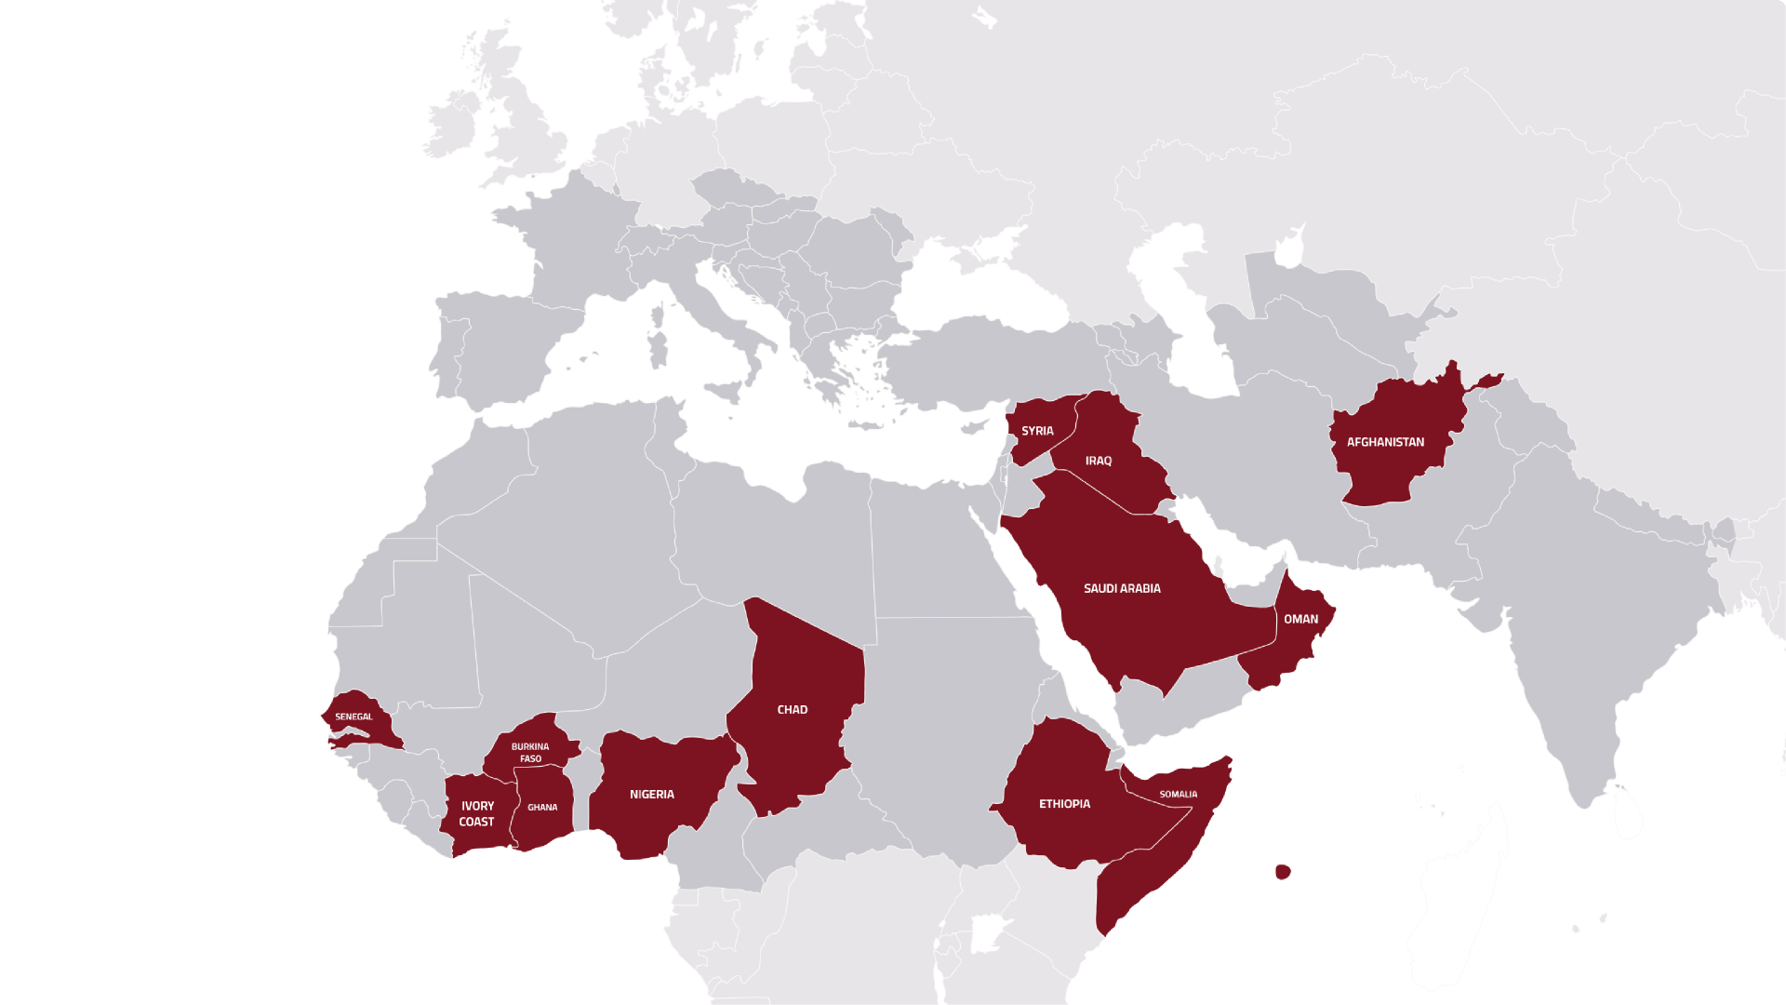
INTERNATIONAL PROJECTS
Projects delivered across:

Slide 6
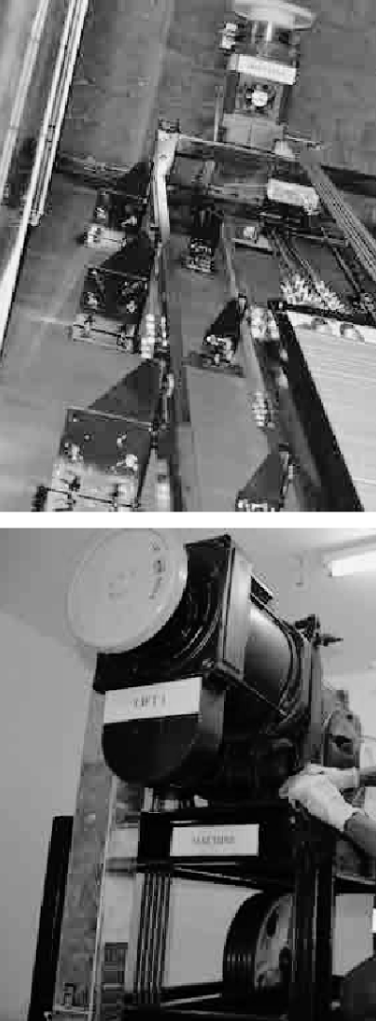


OUR STRENGTH
Scaling Together
20+ Years of Engineering Excellence
4,000+ Elevators & Escalators Supplied
24/7 Emergency Support
Customized Designs
200+ Engineers & Technicians
50+ Local & International Projects
7 UAE Offices
High-Speed Elevator Expertise

Slide 7

LEADERSHIP & EXPERTISE
Driving Results Through Experience
Technical Expertise
Engineering Excellence
Proven Project Execution
Leadership Built on Integrity
Operational Excellence

Slide 8
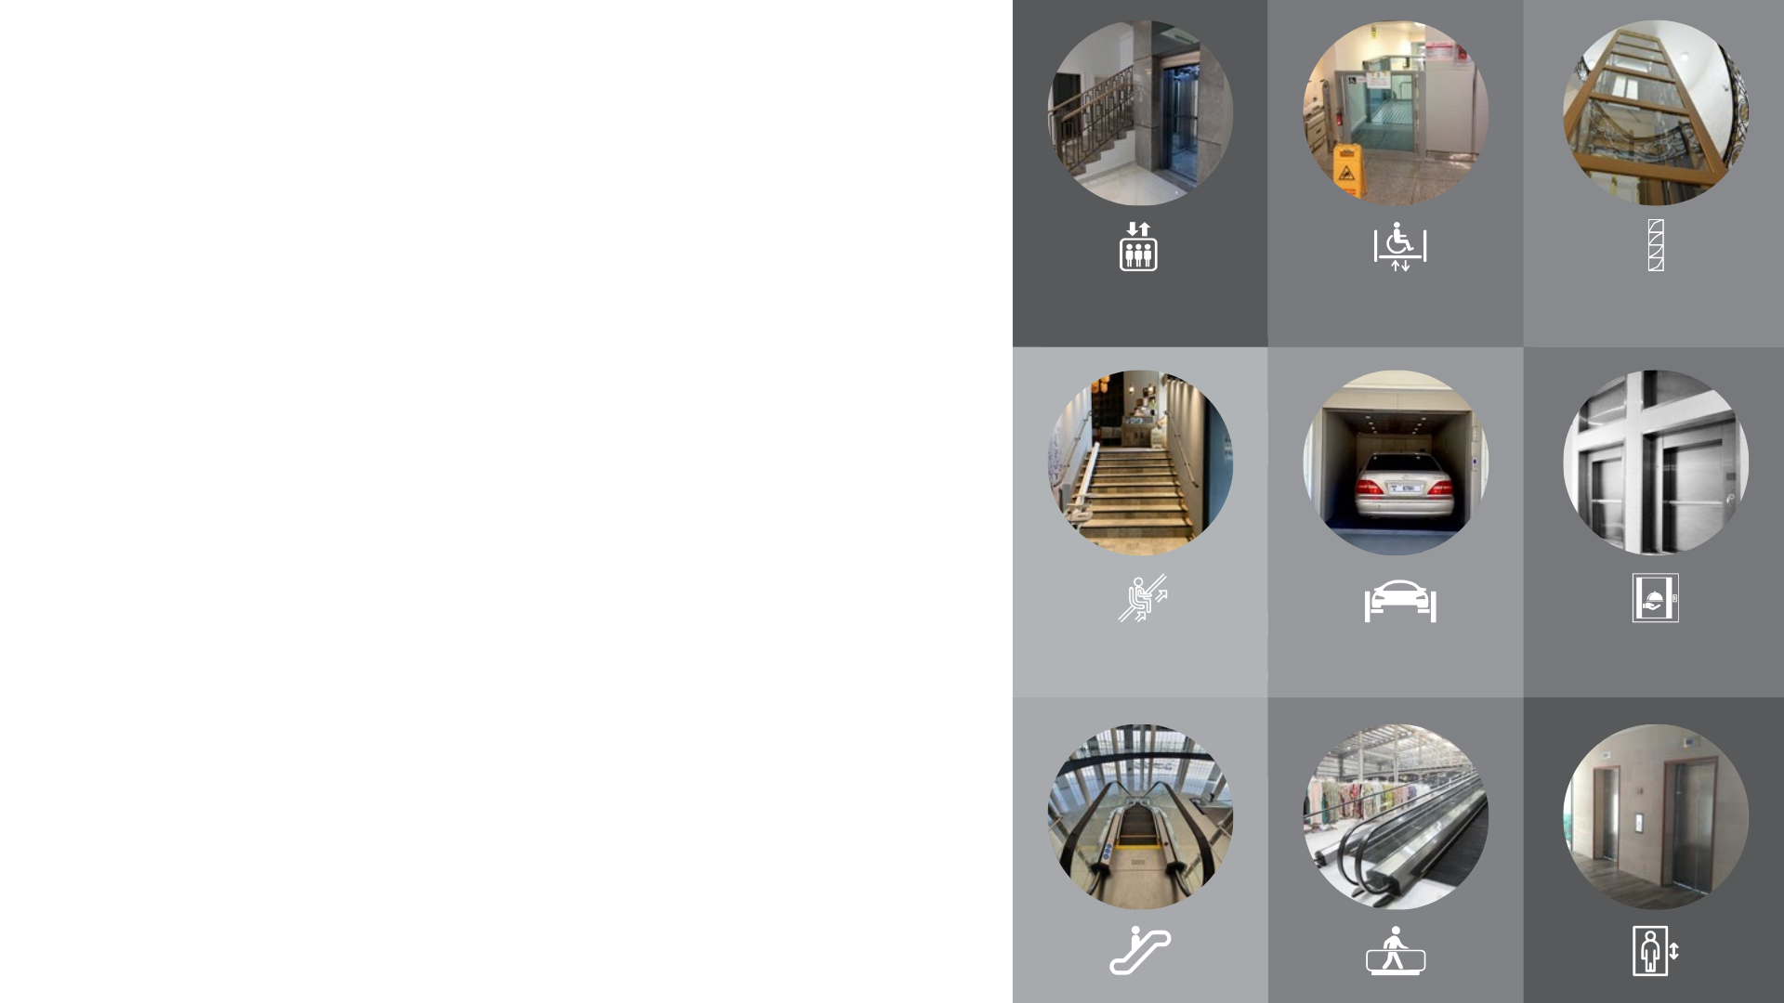






PRODUCT PORTFOLIO
Complete Vertical Mobility Solutions
Elevator Solutions
Accessibility Solutions
Mobility Systems
Structural Solutions

Slide 9


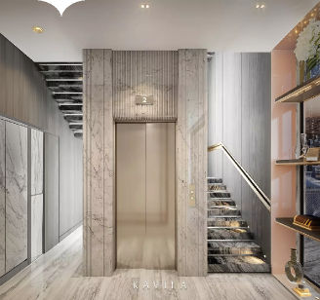

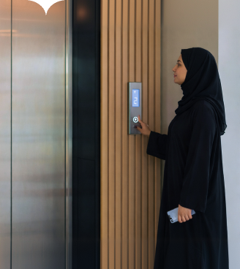

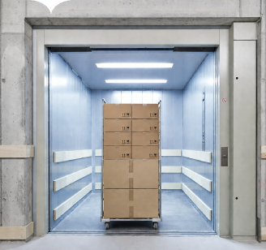

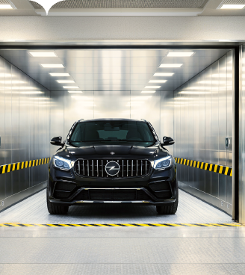
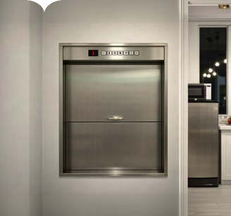

Elevator Solutions
Villa Lifts
Freight Elevators
Dumbwaiters
Passenger Elevators
Car Elevators

Slide 10

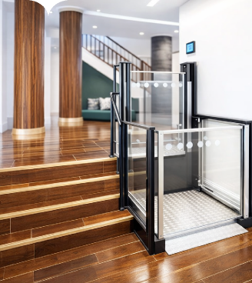
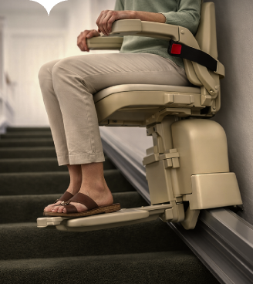
Accessibility Solutions
Platform Lifts
Stair Lifts

Slide 11
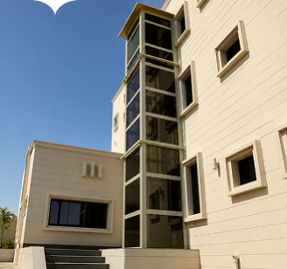
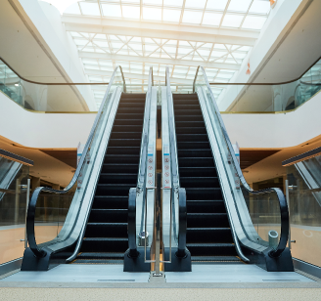
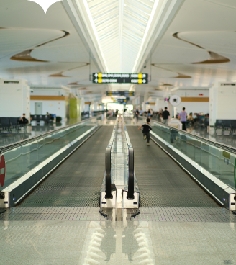
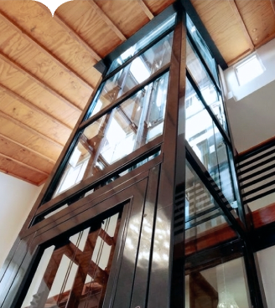
Mobility Systems & Structural Solutions
Escalators
Structural Steel Shafts
Moving Walkways
Metallic Shaft Structures

Slide 12
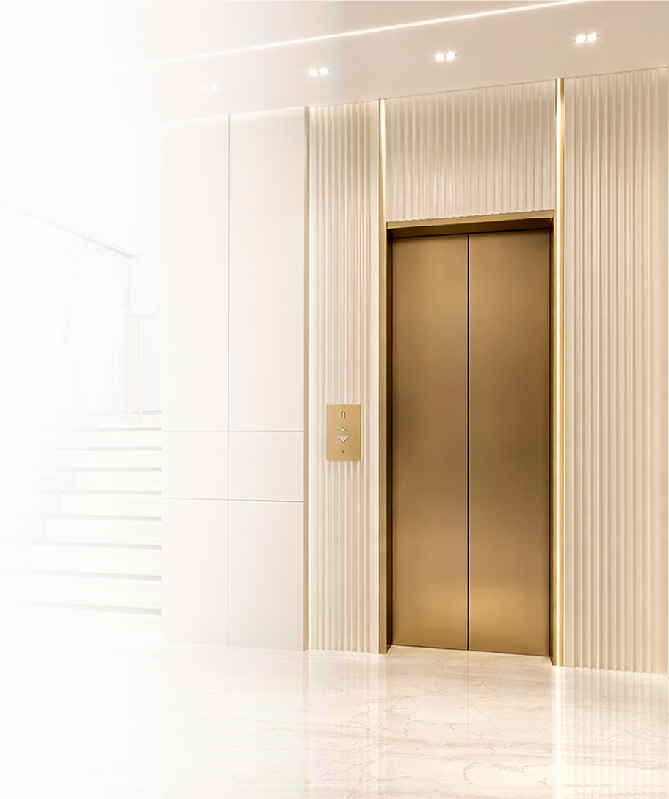
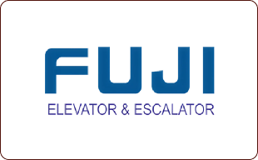
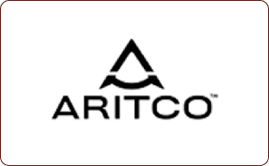
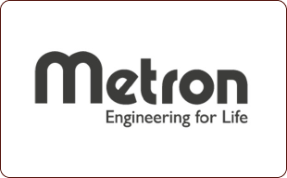
CLIENTS
Trusted by Leading Organizations

Slide 13
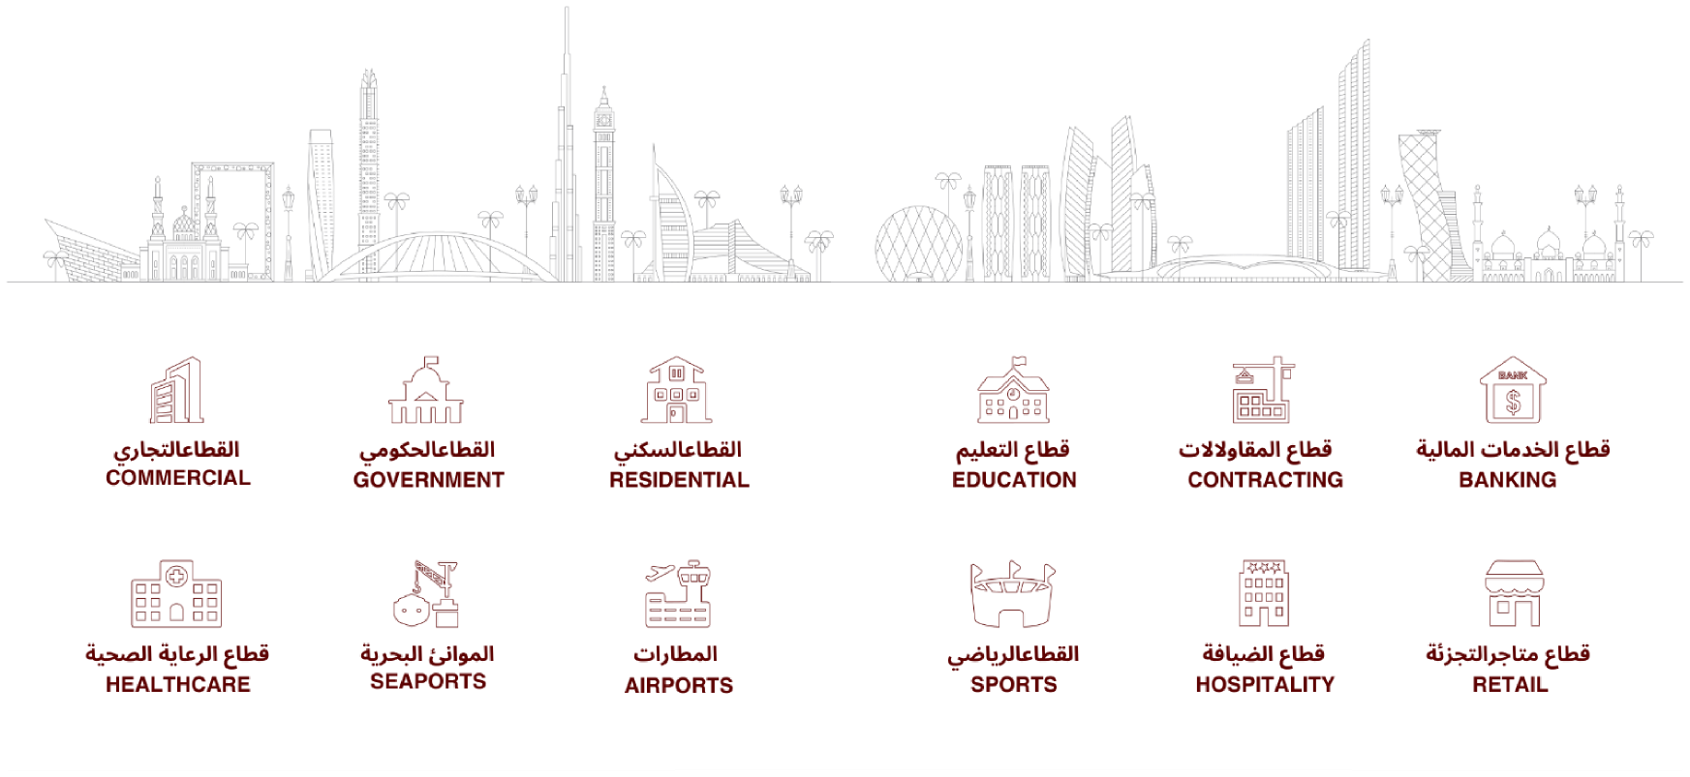
Industries We Serve

Slide 14
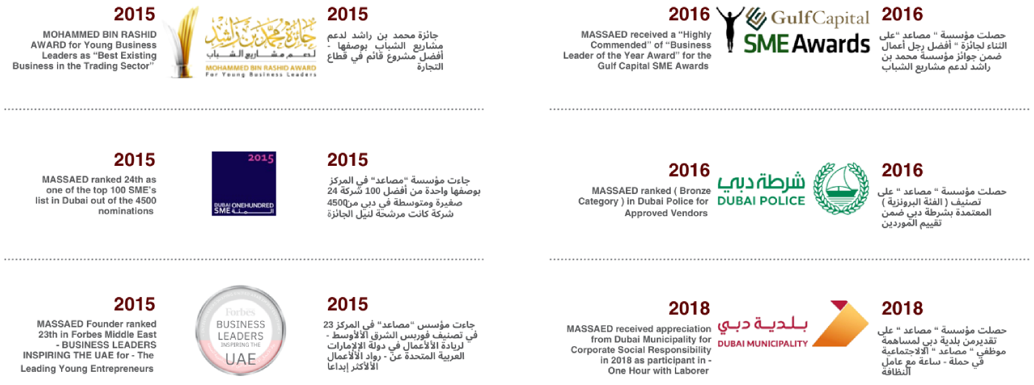
Awards & Government Recognition

Slide 15

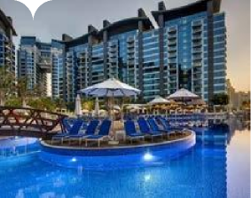

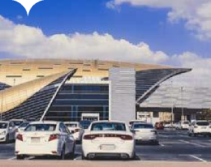
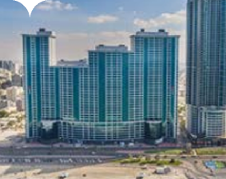
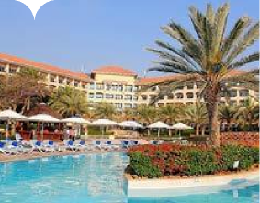

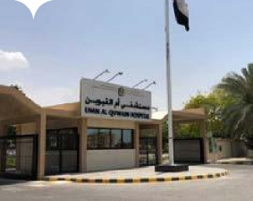
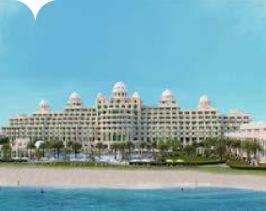
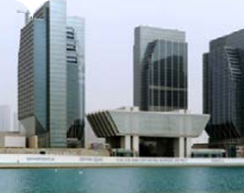
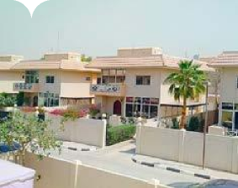
Iconic Projects
Oceana Palm Jumeirah
Client: Schindler Pars International Ltd
Brand: Schindler | Quantity: 12
Metro Green Line
Client: Al Yousuf Electronics LLC
Brand: Fujitec | Quantity: 08
Ajman Residence Phase 1
Client: ThyssenKrupp
Brand: ThyssenKrupp | Quantity: 16
Fujairah Rotana Accommodation
Client: ThyssenKrupp
Brand: ThyssenKrupp | Quantity: 02
Abu Dhabi Financial Center
Client: ThyssenKrupp
Brand: ThyssenKrupp | Quantity: 04
Umm AlQuwawin Hospital
Client: ThyssenKrupp
Brand: ThyssenKrupp | Quantity: 11
Jebel Ali
Client: Ultra Electric Co LLC
Brand: Ultra Electronic | Quantity: 02
Palm Jumeirah Villa
Client: ThyssenKrupp
Brand: ThyssenKrupp | Quantity: 01

Slide 16
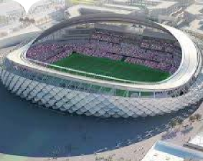
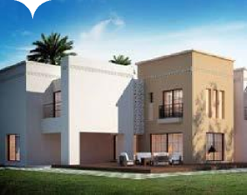
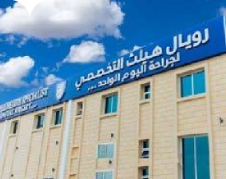
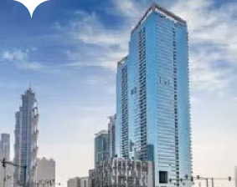

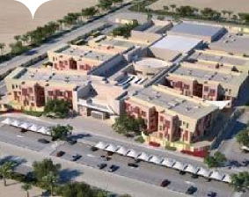
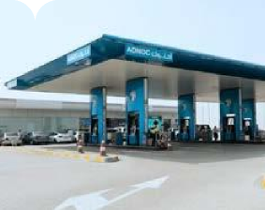
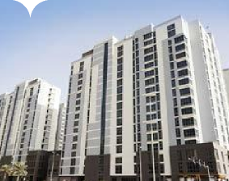
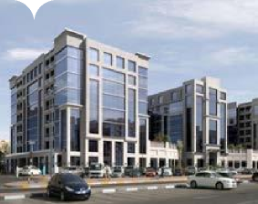

Iconic Projects
Al Ain Stadium
Client: KONE
Brand: KONE | Quantity: 02
Al Ain Villa
Client: KONE Middle East UAE
Brand: KONE | Quantity: 01
Center for One Day Surgery Al Ain
Client: KONE Middle East UAE
Brand: KONE | Quantity: 01
Tiara United Towers
Client: KONE Middle East UAE
Brand: KONE | Quantity: 16
Al Ain Schools
Client: KONE Middle East UAE
Brand: KONE | Quantity: 02
Mazyad Station Al Ain
Client: KONE Middle East UAE
Brand: KONE | Quantity: 01
Atlantis Staff Accomodation
Client: KONE Middle East UAE
Brand: KONE | Quantity: 05
KONE Transemirates
Client: KONE Middle East UAE
Brand: KONE | Quantity: 06

Slide 17


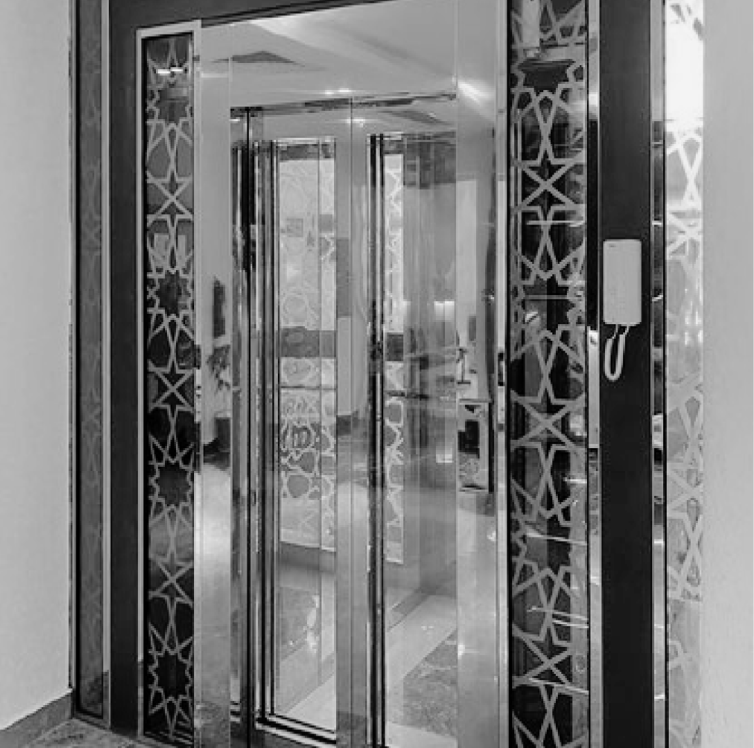



FACTORY BUSINESS PRODUCTS & SERVICES
Factory Business
1
Elevator Manufacturing
2
Steel Fabrication
3
Structural Steel Shafts
4
Custom Engineering
5
Component Production
6
Quality Assurance
7
Manufacturing Excellence

Slide 18



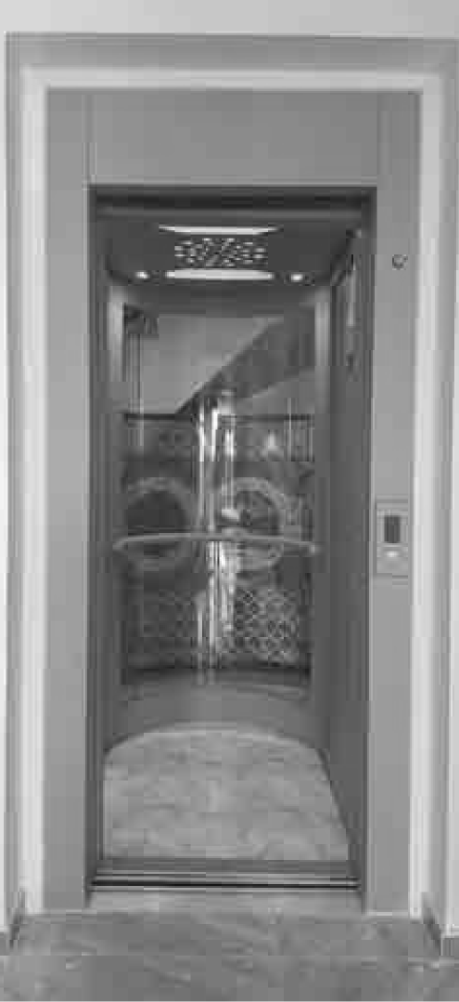
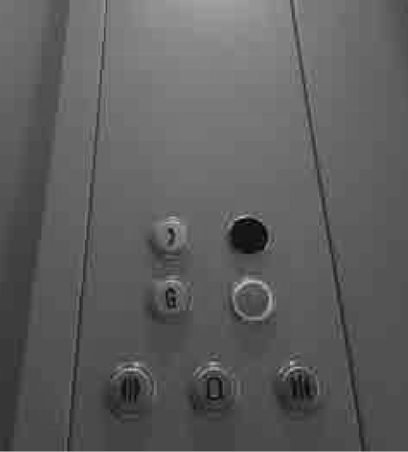
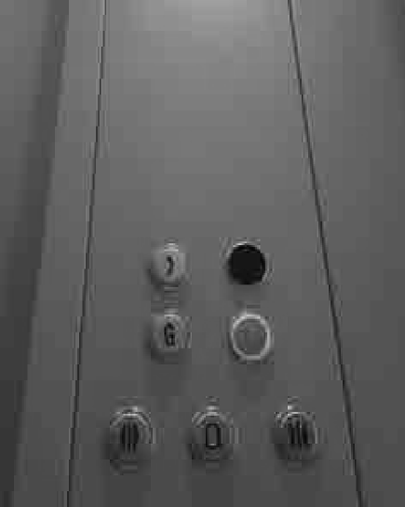




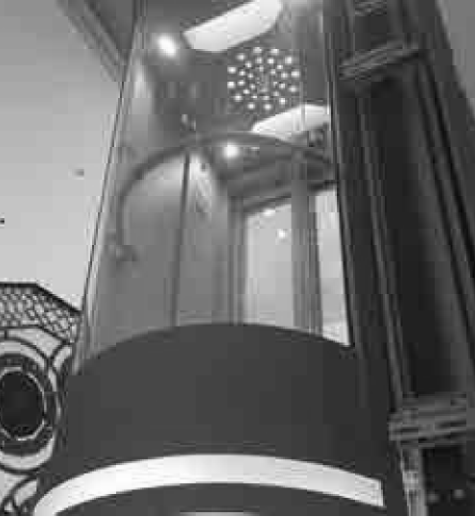



Building the Future of Vertical Mobility
SAFE. RELIABLE. INNOVATIVE.
YOUR EMIRATI PARTNER IN LUXURY

